Slide 1
Attention is All you need
Someone

Slide 2
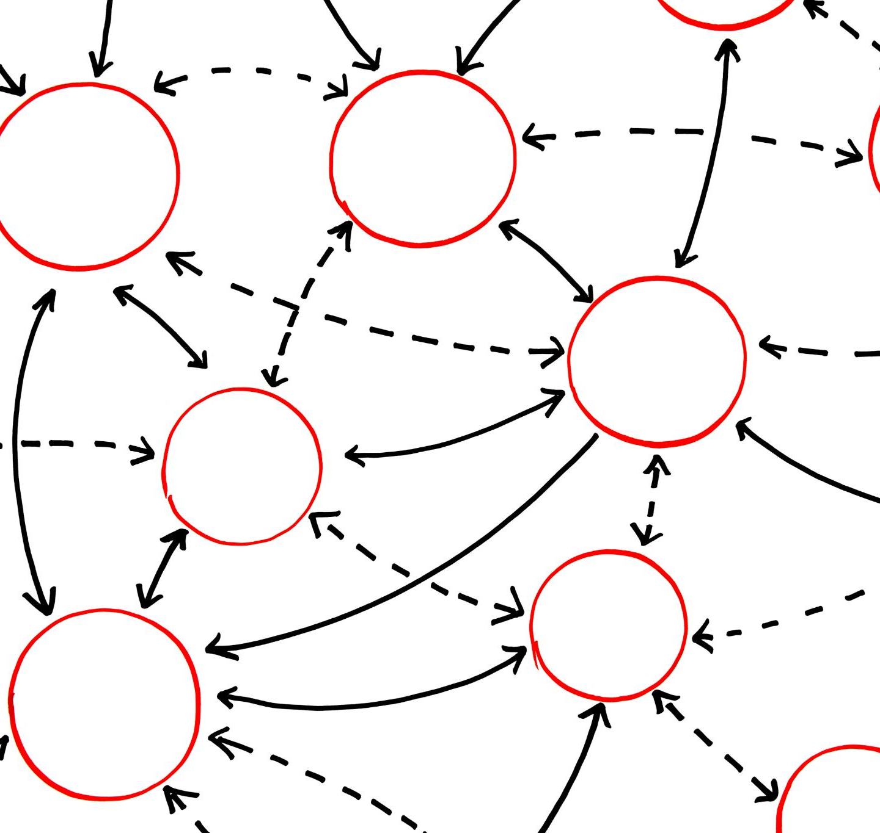
Attention Is All You Need
Introduction of Transformer Model
The paper introduces the Transformer model that revolutionized natural language processing with self-attention mechanisms.
Enhances Parallelization
The self-attention mechanism in the Transformer model enhances parallelization and reduces training time significantly.
State-of-the-Art Performance
The Transformer model achieves state-of-the-art performance on various NLP tasks such as translation, summarization, and question answering.
Notes:
The paper 'Attention is All You Need' introduces the Transformer model. It revolutionized natural language processing by using self-attention mechanisms. This model enhances parallelization and reduces training time, while achieving state-of-the-art performance on various tasks such as translation, summarization, and question answering.

Slide 3
Add a Slide Title - 5

